Slide 1



Slide 2

Remote Printing
Group Members:
Kaleem Ullah(FA16-BCS-067)
Sajjad Ali (FA16-BCS-070)
Supervised by:
Miss Tahira Sadaf
Presented on 19 July,2020
Department of Computer Science
COMSATS University Islamabad, Attock Campus

Slide 3
Outline
_______________________________
Introduction
Related Work / Applications
Problem statement
Objectives
Methodology
Diagrams
Modern tools
Project Implementation
Future Work
References
_______________________________

Slide 4
Introduction
_______________________________
This project will print the user document.
The system will accept document files from user and print it for user.
The system will send a conformation notification on task completion or warning notification if not enough balance.
The system will only work at the working 24/7 but printing will proceed only by admin.
In case of any failure or emergency the admin can stop the system and the system will stop accepting new requests.
_______________________________

Slide 5
Related Applications
_______________________________
Name | Weakness | Proposed Solution
Teamviewer | Unsecure for shop Limited usage | Secure for admin and user Unlimited usage
Printeron | Expensive | Cheap
_______________________________

Slide 6
Problem Statement
_______________________________
Improper use of printer by user
Non paid bills by user
Unavailability of printer
Waste pages problem
Printer-bounded by a single user
USB/Data-Cable unavailability
Corruption of file/USB due to virus
_______________________________

Slide 7
Objectives
_______________________________
To increase printing productivity and reduce time consuming.
Problem Solution for Proposed System
Using the concept of first come first serve approach
Online wallet
Kept record of prints and payments in the database
Generating error messages to user and admin
Send notifications to user
Alert user for double printing request
Android app for notifications
Professional UI
_______________________________

Slide 8
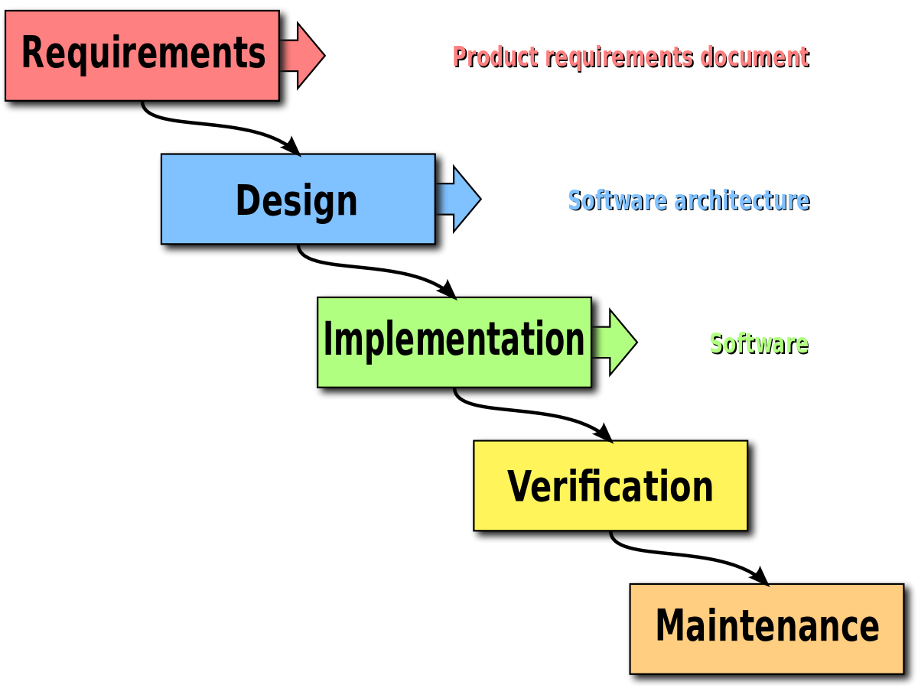
Methodology
_______________________________
We will follow object oriented approach which is adapted by most modern technologies. The OOP is very helpful for its reusability. We will follow waterfall development modal because we want to develop the system in step by step manner.
_______________________________

Slide 9
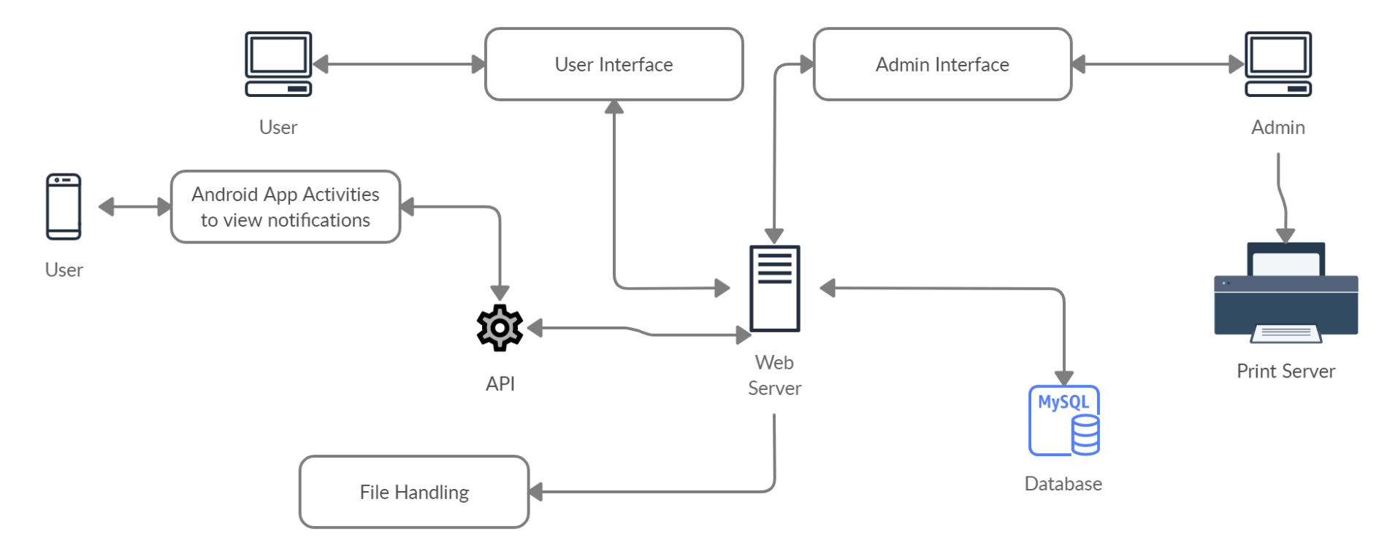
Architecture Diagram
_______________________________
_______________________________

Slide 10
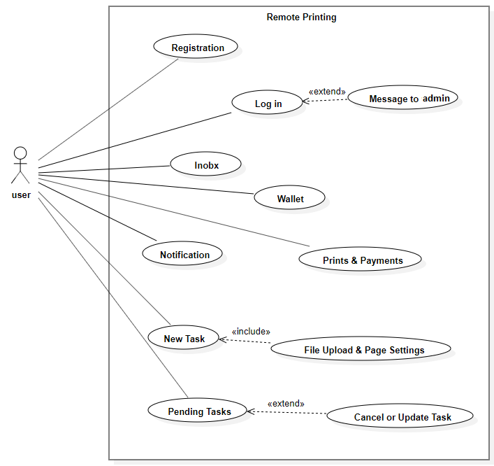
Use Case Diagram
_______________________________
_______________________________
User Use Case diagram

Slide 11
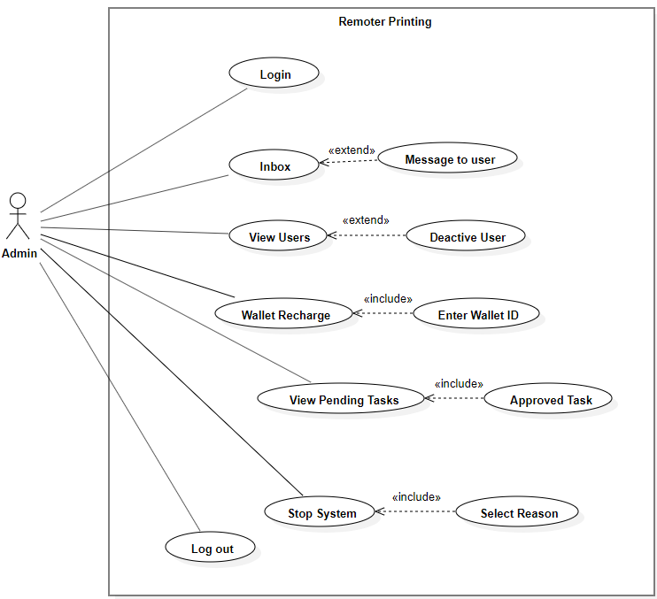
Use Case Diagram
_______________________________
_______________________________
Admin Use Case diagram

Slide 12
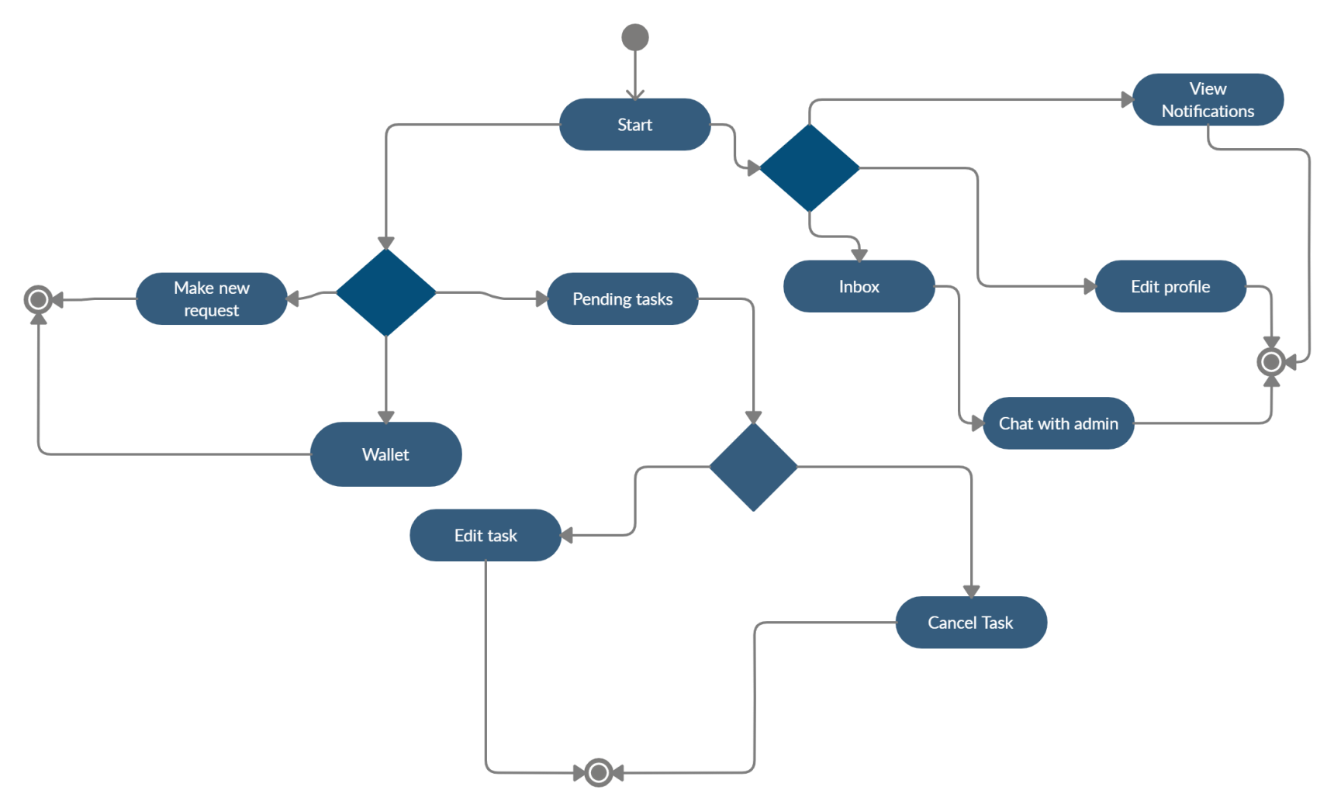
Activity Diagram
_______________________________
_______________________________
User Activity Diagram

Slide 13
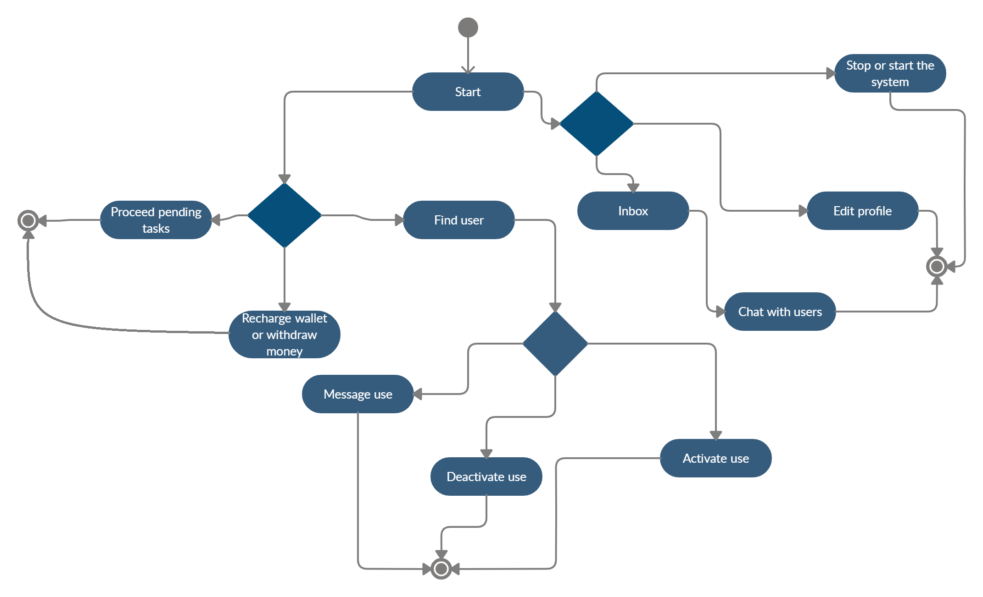
Activity Diagram
_______________________________
_______________________________
Admin Activity Diagram

Slide 14
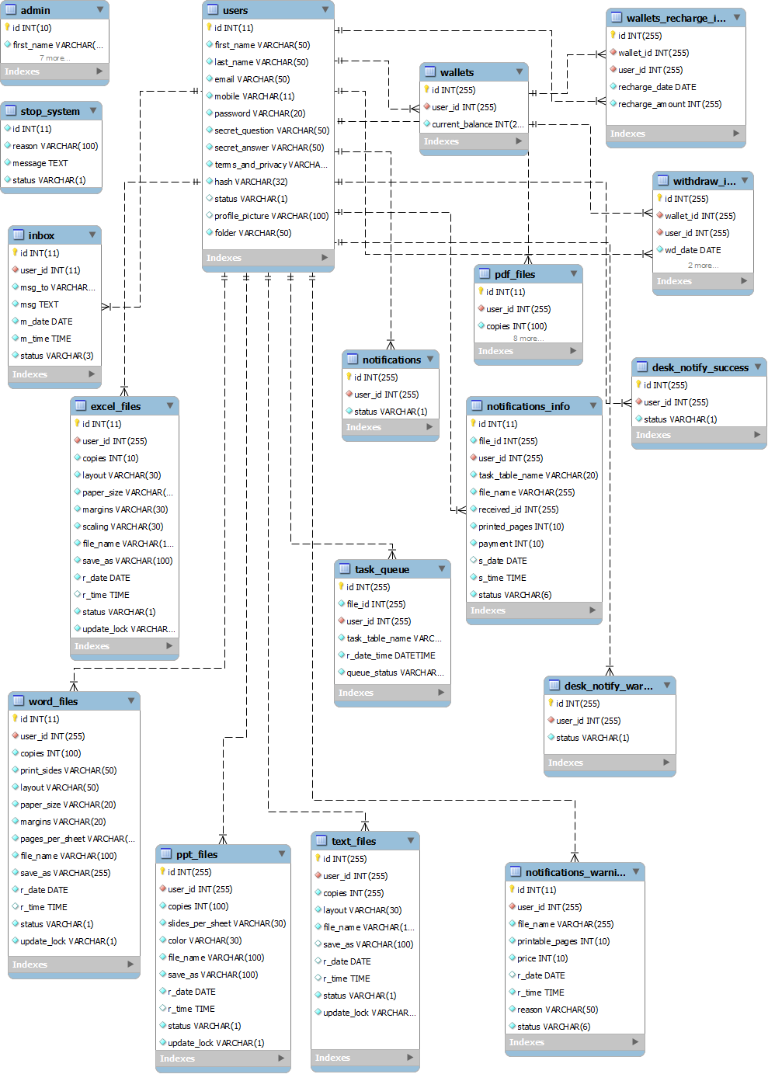
ERD
_______________________________
_______________________________
ERD

Slide 15
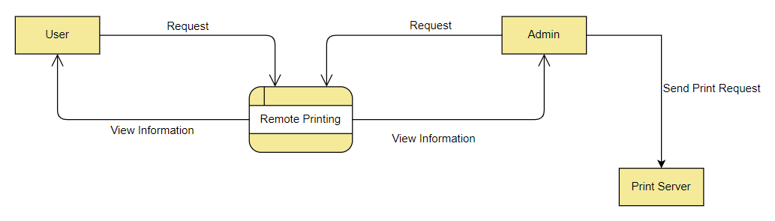
DFD
_______________________________
_______________________________
DFD Level 0

Slide 16
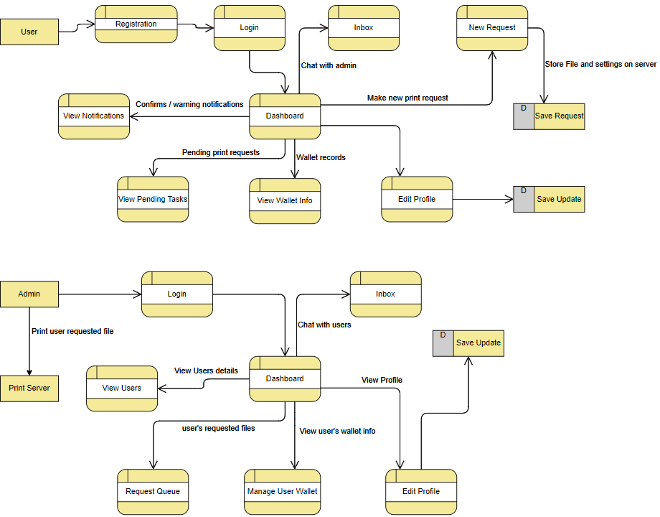
DFD
_______________________________
_______________________________
DFD Level 1

Slide 17
Modern Tools
_______________________________
Technologies:
PHP
Tools:
Brackets
Xampp Server
MS Word
MS PowerPoint
Creately Online
MySQL
HTML
CSS
Bootstrap
JavaScript
query
Android Studio
Modern Tools
_______________________________

Slide 18
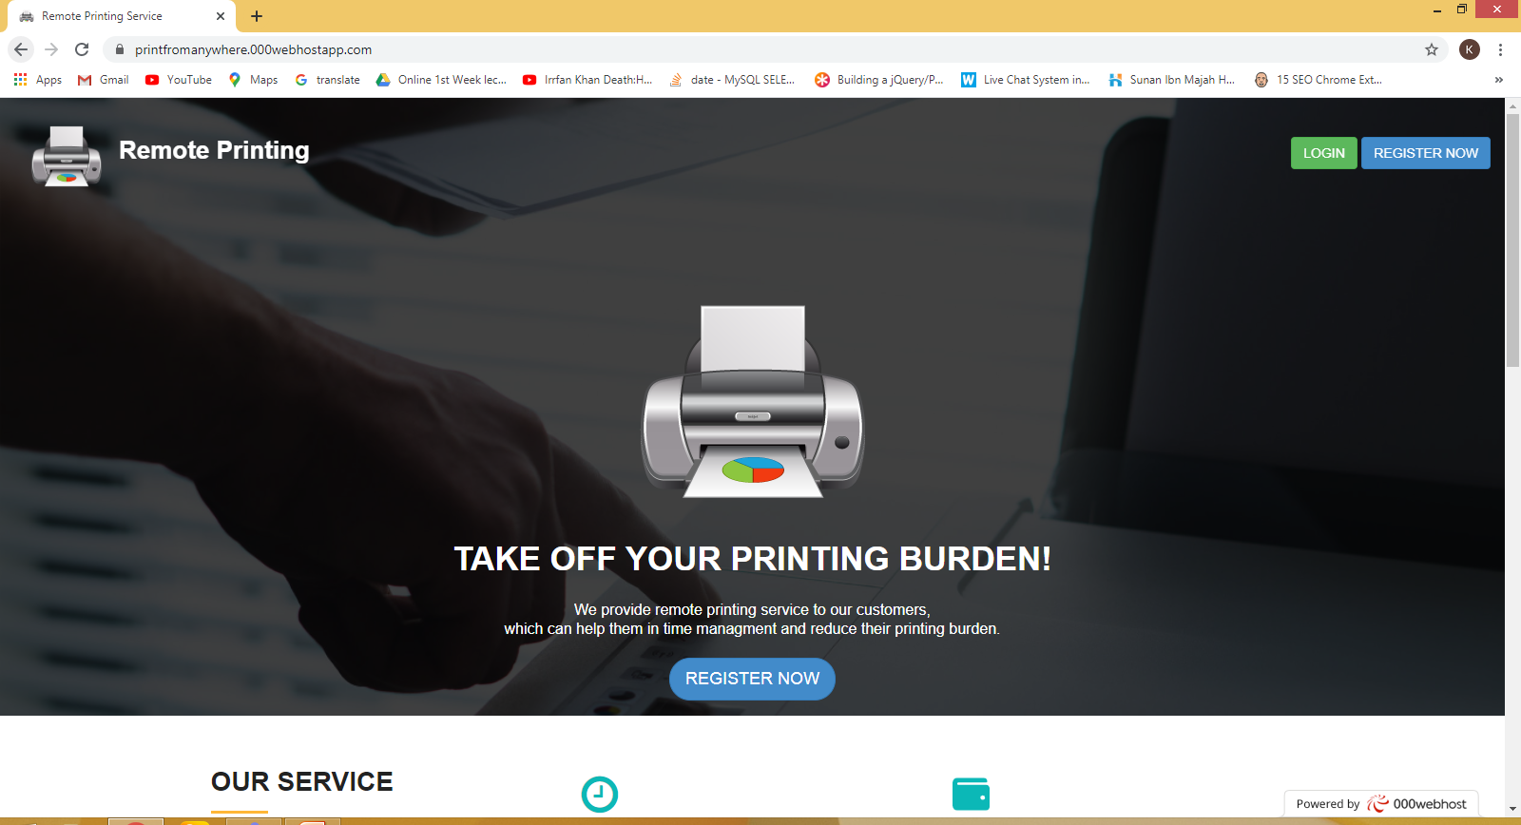
Project Implementation
_______________________________
_______________________________

Slide 19
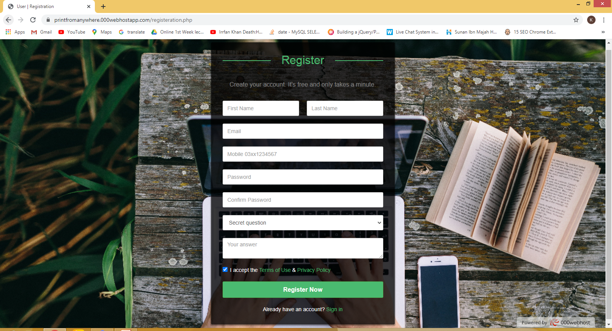
Project Implementation
_______________________________
_______________________________

Slide 20
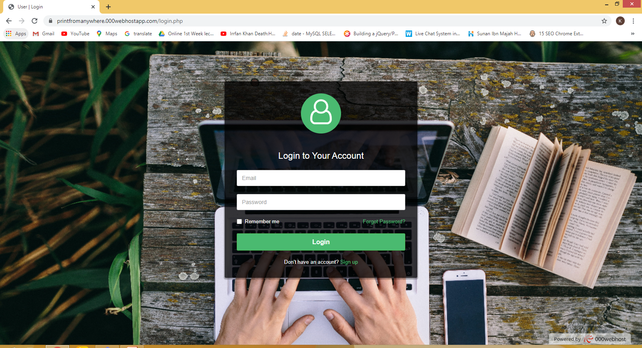
Project Implementation
_______________________________
_______________________________

Slide 21
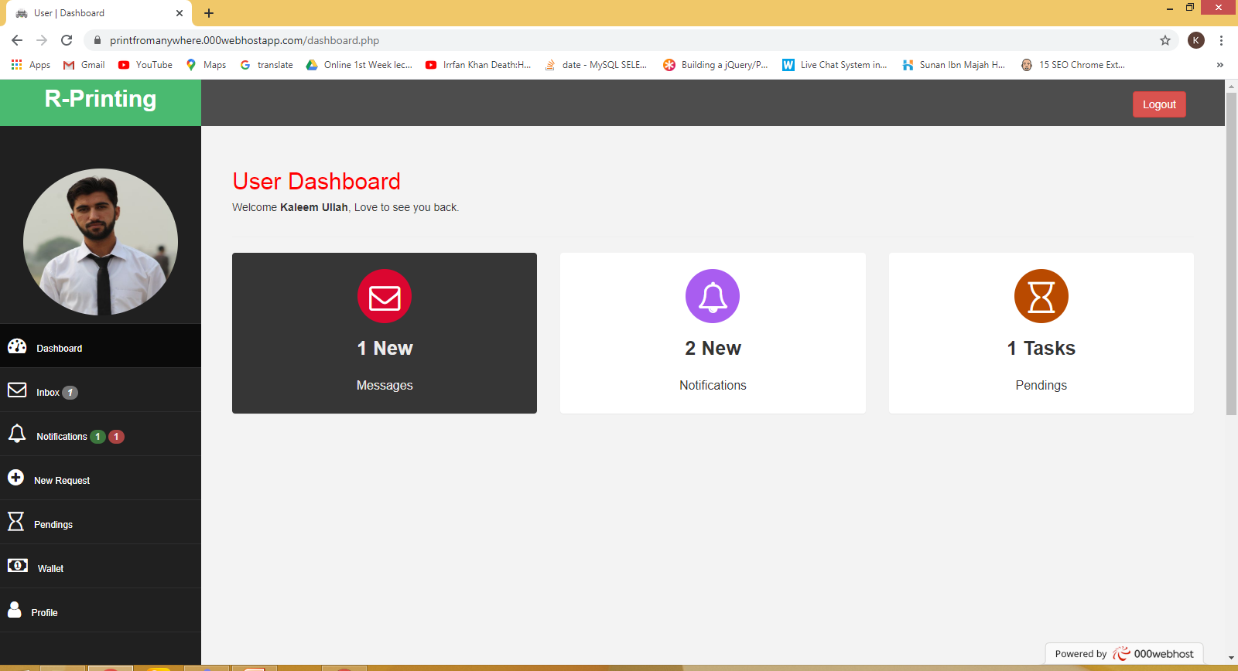
Project Implementation
_______________________________
_______________________________

Slide 22
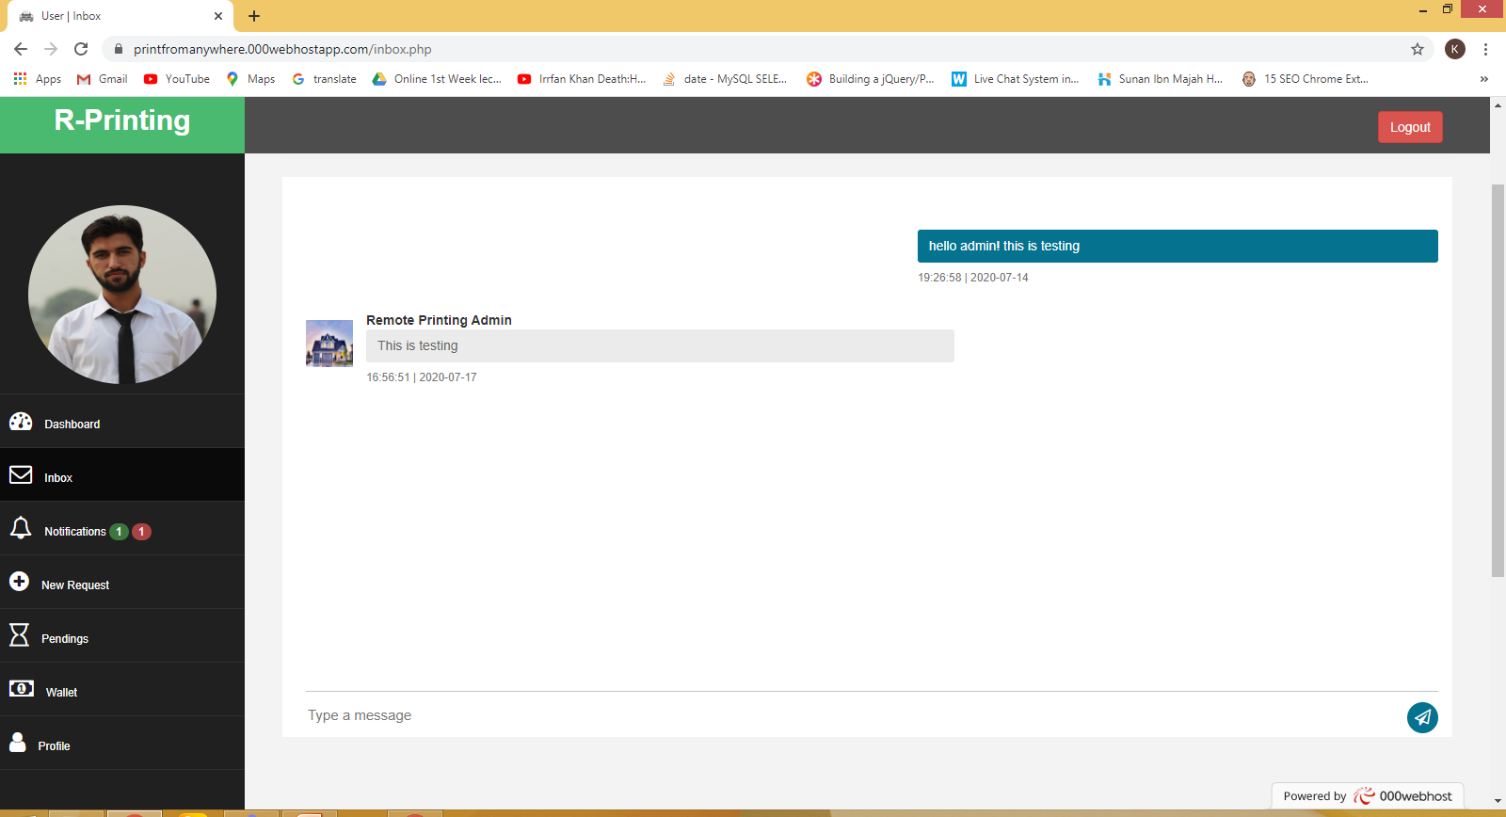
Project Implementation
_______________________________
_______________________________

Slide 23
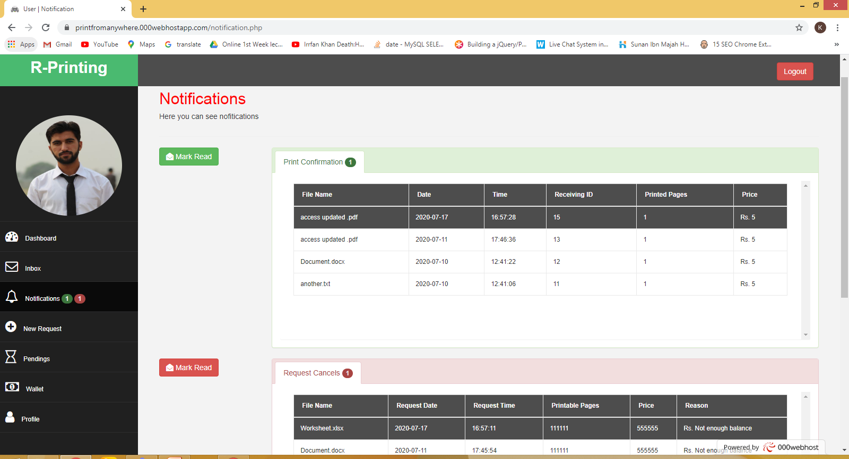
Project Implementation
_______________________________
_______________________________

Slide 24
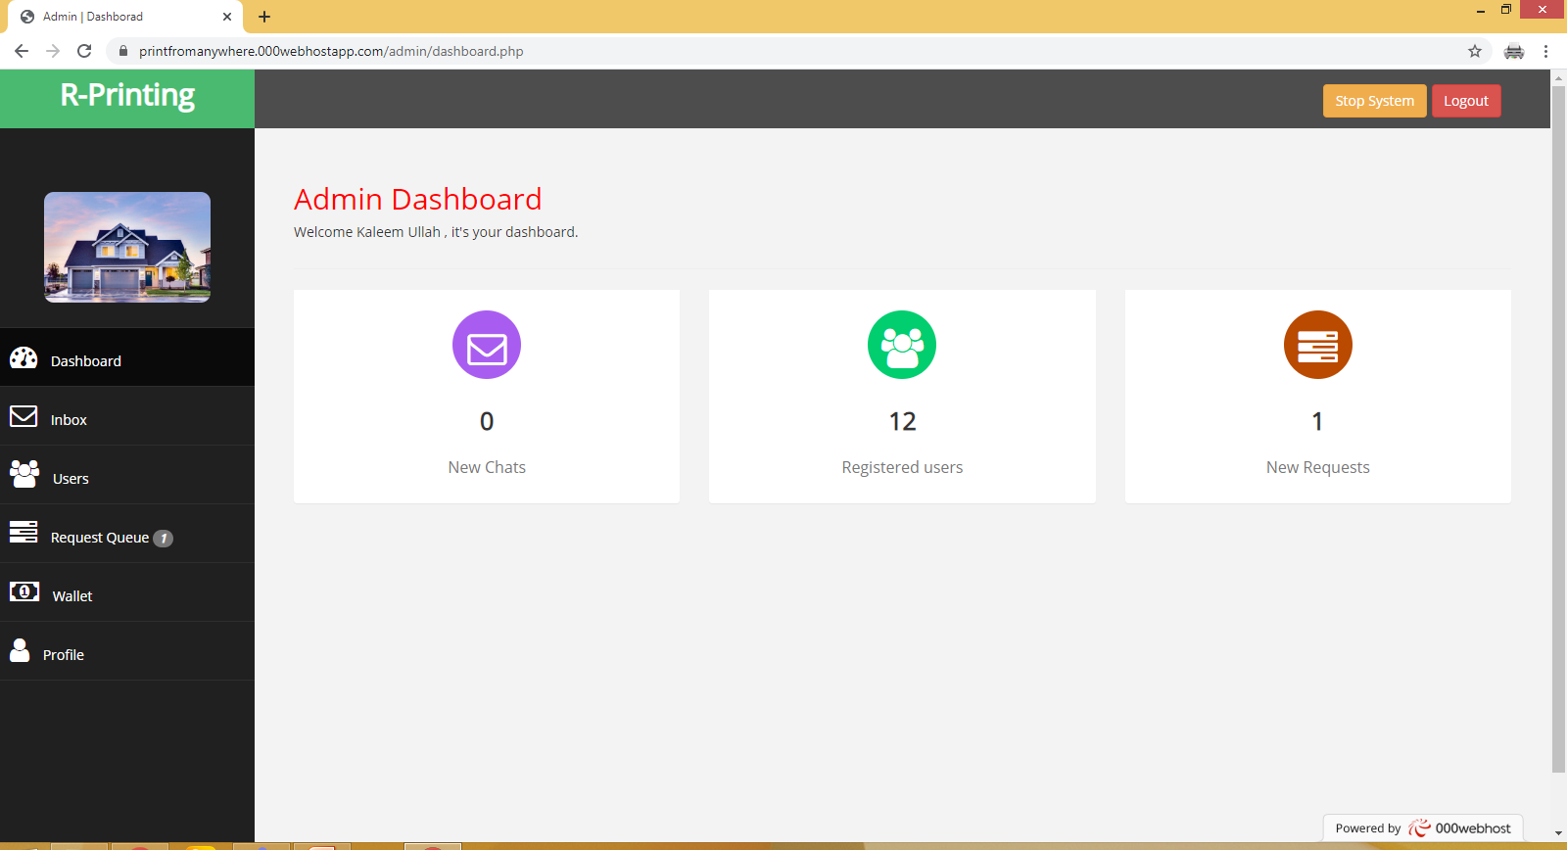
Project Implementation
_______________________________
_______________________________

Slide 25
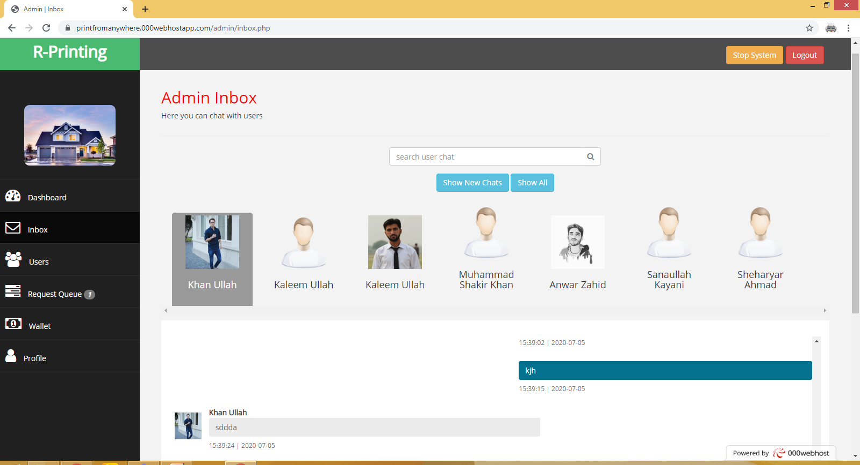
Project Implementation
_______________________________
_______________________________

Slide 26
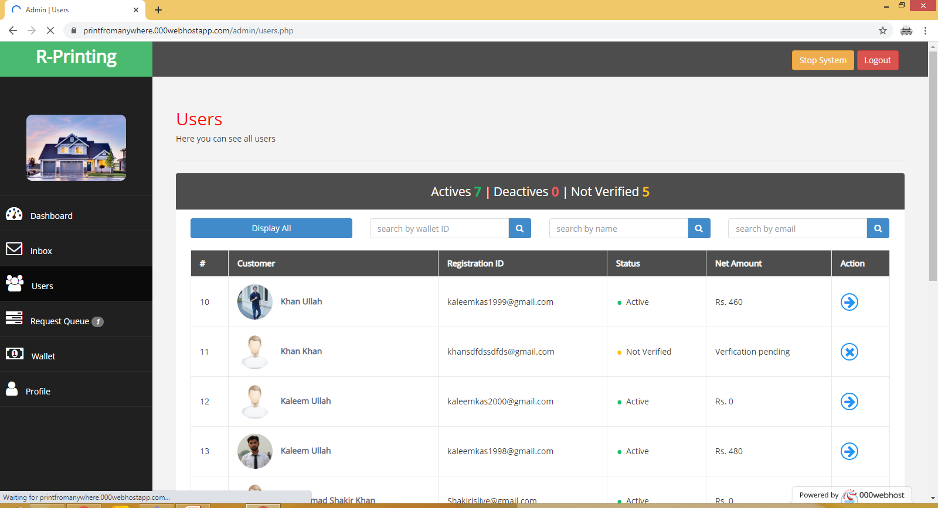
Project Implementation
_______________________________
_______________________________

Slide 27
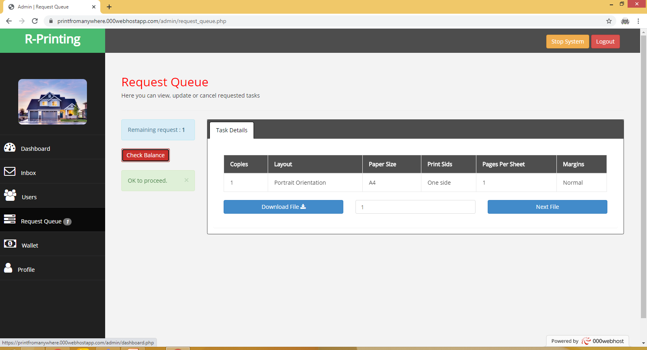
Project Implementation
_______________________________
_______________________________

Slide 28
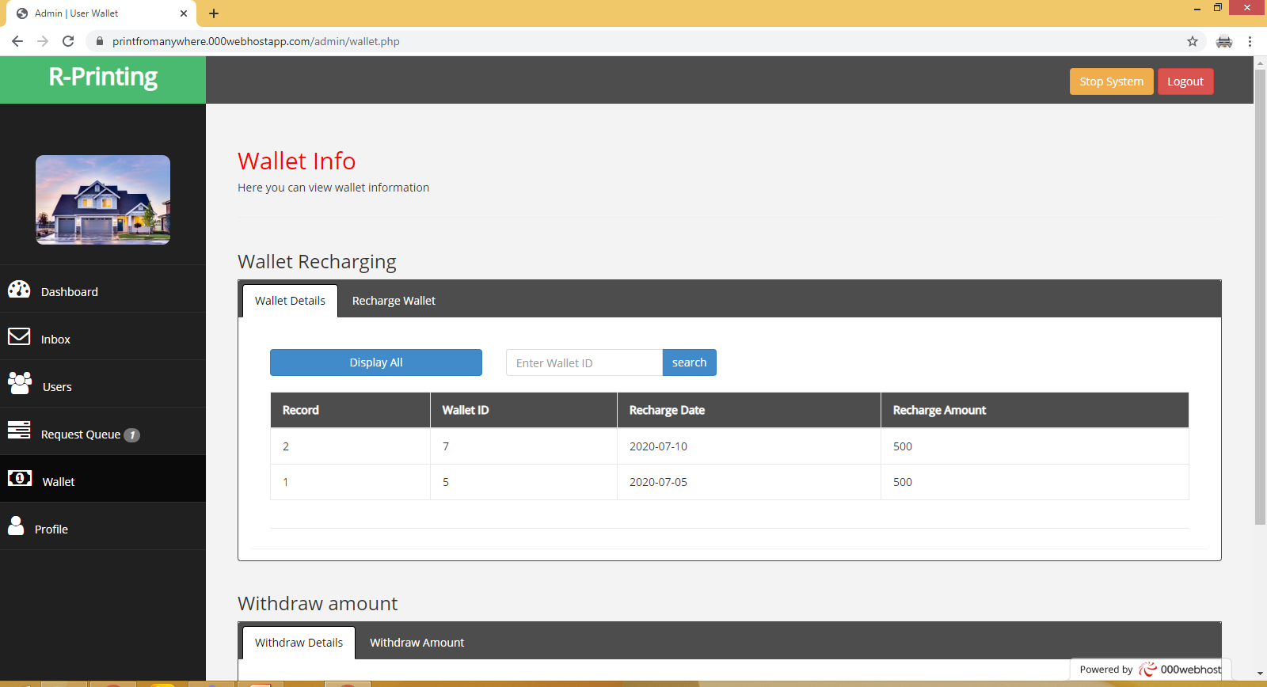
Project Implementation
_______________________________
_______________________________

Slide 29
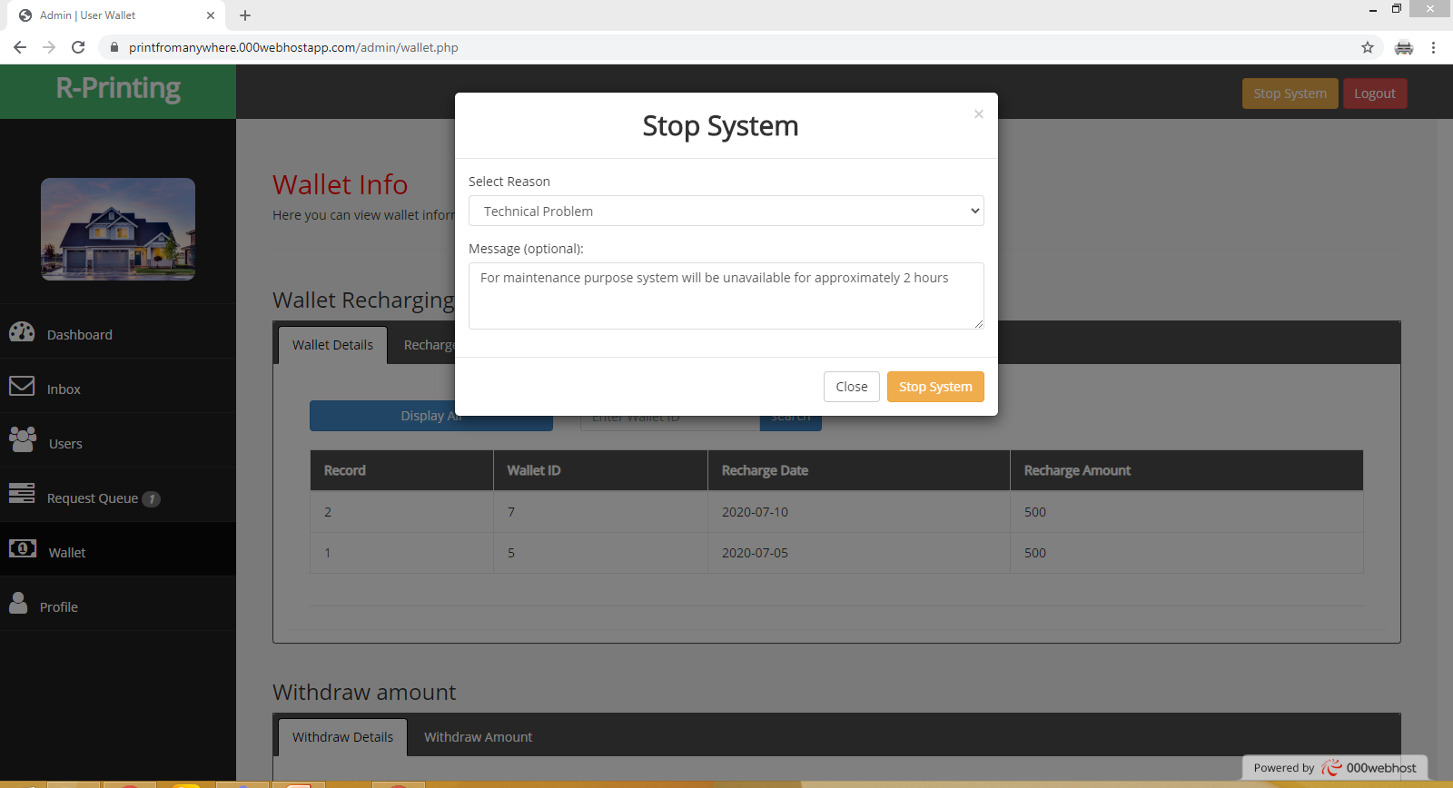
Project Implementation
_______________________________
_______________________________

Slide 30
Future Work
_______________________________
Remote printing can be improved by creating complete android app. Home delivery service can start for premium users. The system can be integrating with standard payment methods like credit card, easy paisa, jazz cash etc. Printing request can extend with extra services e-g spiral binding, complete book printing, photos, banners etc.
_______________________________

Slide 31
References
_______________________________
Dan Dascalescu, JavaScript - Chrome desktop notification example - Stack Overflow, https://stackoverflow.com/questions/2271156/chrome-desktop-notification-example
Chris Bier, php - Storing and reading images above public_html - Stack Overflow, https://stackoverflow.com/questions/1415973/storing-and-reading-images-above-public-html
David Walsh, Detect Online Connection with JavaScript, https://davidwalsh.name/detecting-online
Creately Team, ER Diagram, https://creately.com/diagram-type/template/gstx57ng1/er-diagram

Slide 32
References
_______________________________
Chris Coyier , Building a jQuery/PHP Powered Chat Room | CSS-Tricks https://css-tricks.com/jquery-php-chat/
Refsnes Data, W3Schools Online Web Tutorials, https://www.w3schools.com/
CodePen team, CodePen: Build, Test, and Discover Front-end Code, https://codepen.io/
Tutorialspoint Team, PHP Tutorial – Tutorialspoint, https://www.tutorialspoint.com/php/index.htm
Kevin Skoglund, lynda-php-with-MySQL-beyond-the-basics, http://www.skillscola.com/lynda-php-with-mysql-beyond-the-basics/

